Slide 1
Optical Character Recognition
Subhash N
Sri Manakula Vinayagar Engineering College,Pondicherry

Slide 2

Problem Statement
The pandemic has accelerated a need for digitizing of identity and contactless interaction. Develop an application utilizing OCR technology to create a digital version of your physical identity documents.

Slide 3

Stack Used :
OpenCV
Pytesseract
Xlsxwiter

Slide 4

WorkFlow Solution :
Mark the Coordinates of the word
Crop the word as a image using the coordinates
Convert the image to threshold binary
Convert the cropped image to string
Save the data to an Excel file and a JSON

Slide 5
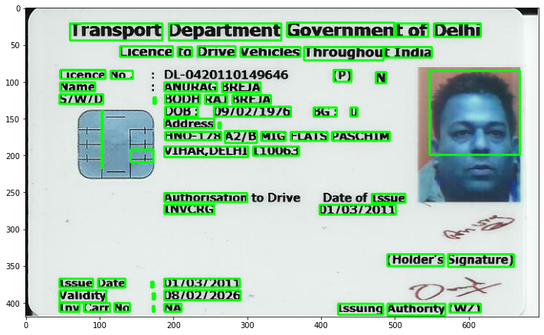

Slide 6
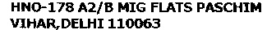

Slide 7
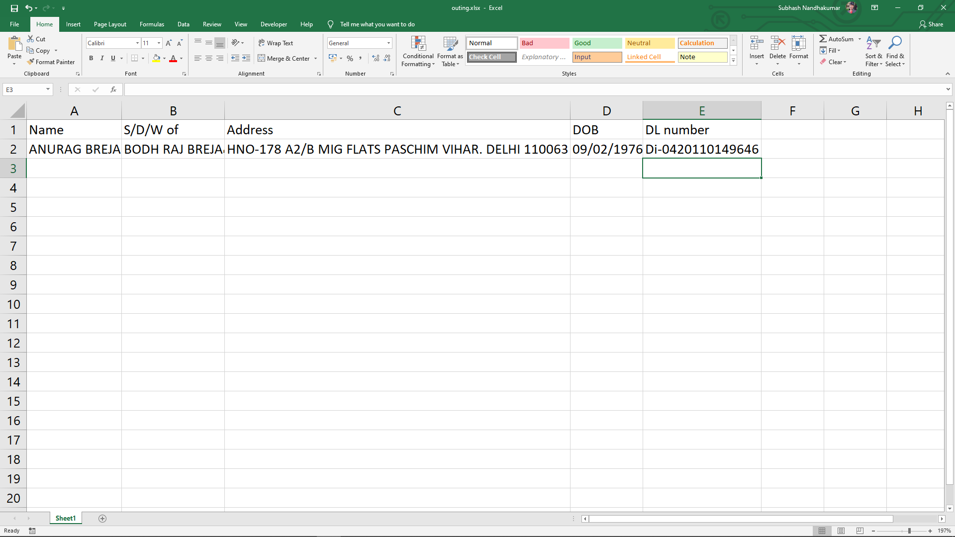

Slide 8
Thank you.

